Slide 1
Yoga Pose Classification,
Analysis and Feedback
Generation Using Deep Learning
Under the guidance of Dr. Partha Garai
Developed by Alok Sarkar and Subrata Halder

Slide 2
Introduction
Yoga & its Benefits:
Improves mood
Keeps us healthy in mind & body
Cures medical condition
It contributes to health awareness and work-life balance.
Difficulties:
Medical
Financial
It’s very difficult to do yoga at home without proper guidance.
It’s not always efficient & so unable to gain full benefits
People end up hurting themselves.

Slide 3
Objective
Create an AI system which assists an individual to perform yoga more efficiently.
To make yoga more accessible to all without the help of a personal instructor.
Help people perform various asanas while maintaining good posture.
Accurately detect a particular yoga asan
Provides Feedback on user performed Yoga Asanas.

Slide 4
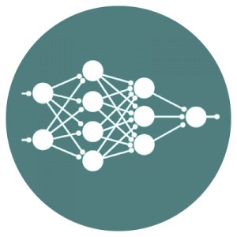
Approaches
Dataset in raw image vs csv
Pre-trained model vs Native model
SVM
CNN + LSTM
CNN+CNN

Slide 5
Comparison of various approaches
No. | Approach | Disadvantages
1 | SVM | SVM algorithm is not suitable for large data sets.
2 | CNN | Large training data needed, doesn't encode the position and orientation of object.
3 | CNN+LSTM | Requires large resources during training
4 | CNN+CNN | Somewhat accuracy loss compared to cnn+lstm model
Model | Accuracy
 | Training | Testing
SVM | 0.9532 | 0.9319
CNN | 0.9934 | 0.9858
CNN + LSTM | 0.9987 | 0.9938
CNN+CNN | 0.9786 | 0.9661

Slide 6
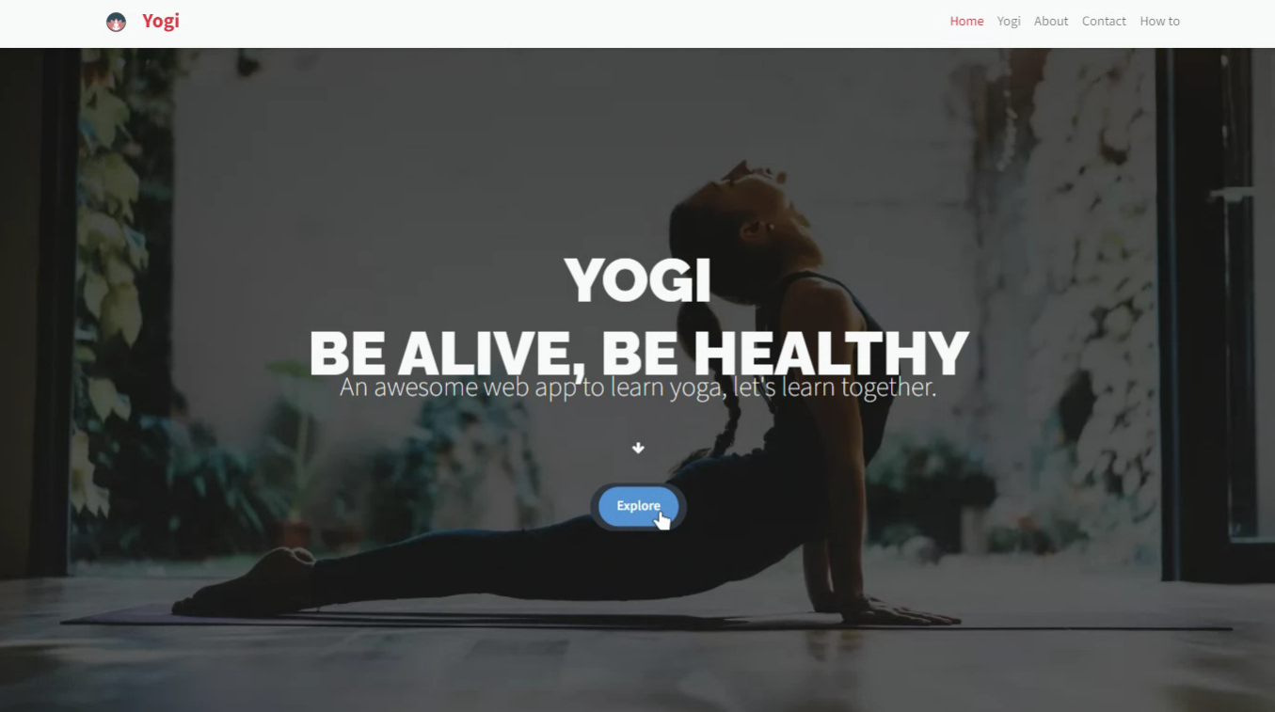
Web App [Landing page]

Slide 7
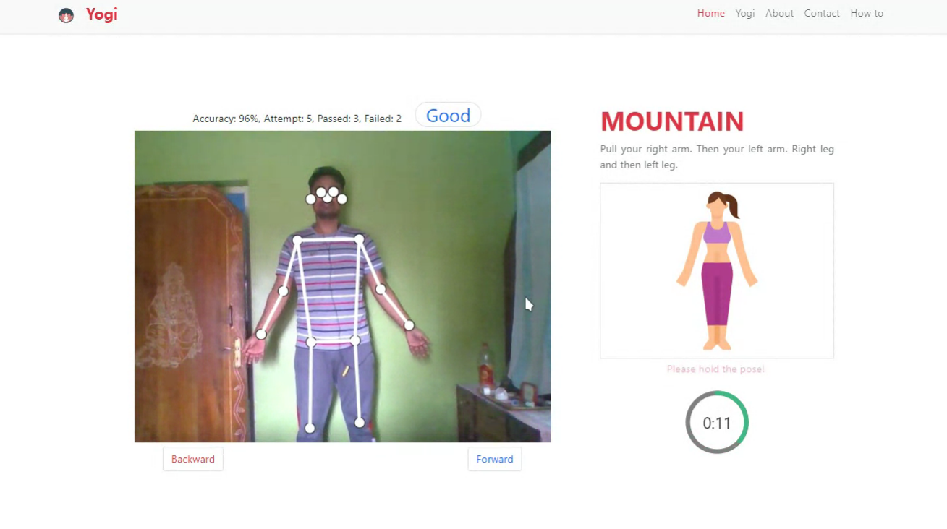
Web App [Mountain Pose Detection]
Mountain pose detection (Accuracy : 96%, Attempt: 5, Passed: 3, Failed: 2, Feedback : Good)

Slide 8
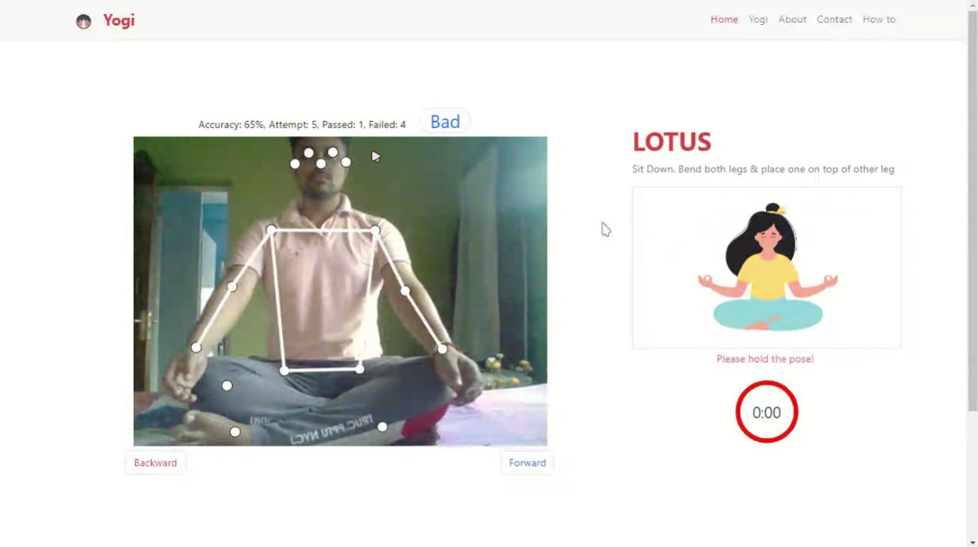
Web App [Lotus pose detection ]
Lotus pose detection (Accuracy : 65%, Attempt: 5, Passed: 1, Failed: 4, Feedback : Bad)

Slide 9
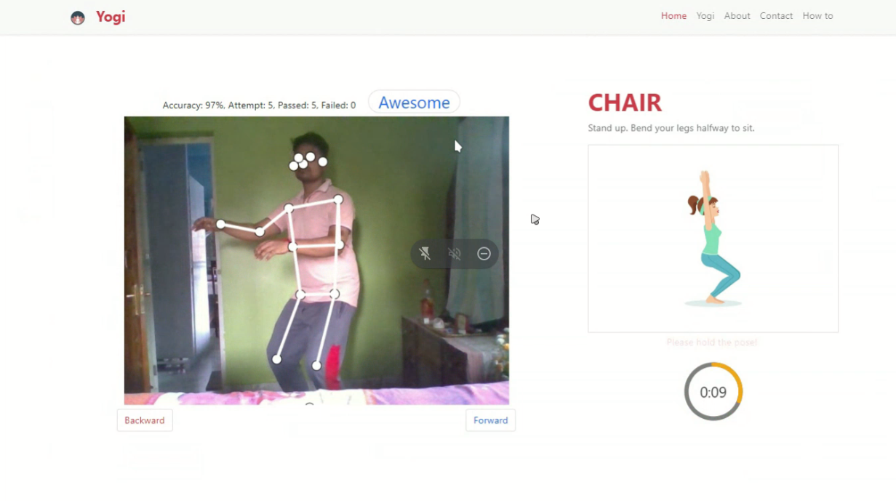
Web App [Chair pose detection ]
Chair pose detection (Accuracy : 97%, Attempt: 5, Passed: 5, Failed: 0, Feedback : Awesome)

Slide 10
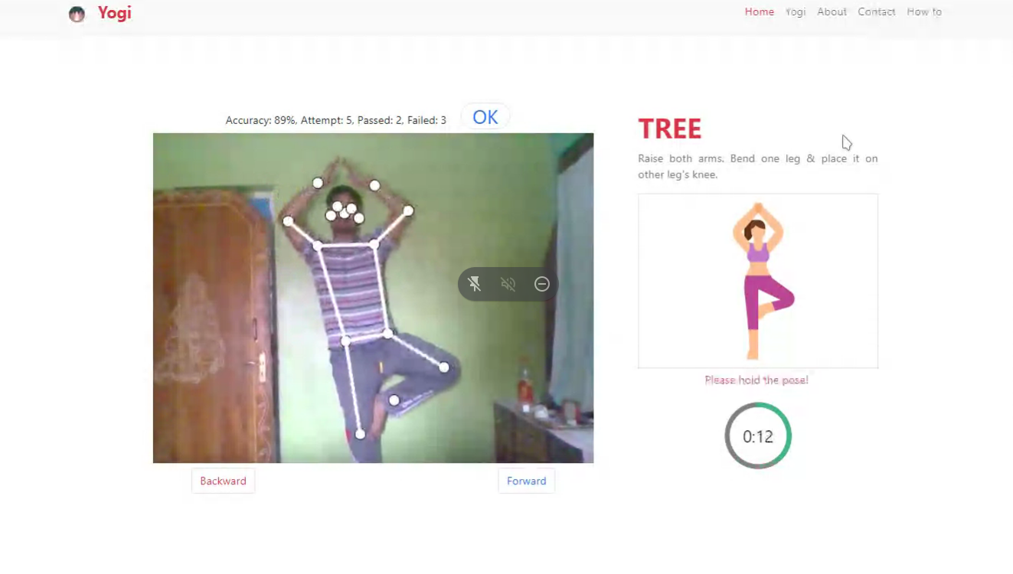
Web App [Tree pose detection ]
Tree pose detection (Accuracy : 89%, Attempt: 5, Passed: 2, Failed: 3, Feedback : OK)

Slide 11
Posenet , Its Advantages & Challenges
Posenet was trained using various dataset including COCO dataset.
Posenet Advantages:
It gives very accurate result .
Less resource hungry
Posenet Disadvantages:
Though it is quite accurate, it does not work on sitting subjects
CLosed Source

Slide 12
Classification Implementation
We gathered dataset accordingly
Divide into train, validate and test
Using tensorflow to implement deep neural network
Define required variables
Labeling
Defined model (here sequential, activation - relu and softmax in dense layer)
Compile model with suitable loss function(categorical cross entropy) and optimizer(Adam)
Defining image generation with augmented factors like rescale, shear, zoom_range, horizontal_flip
Defining image data generation using flow from directory
Plot image for visualizing

Slide 13
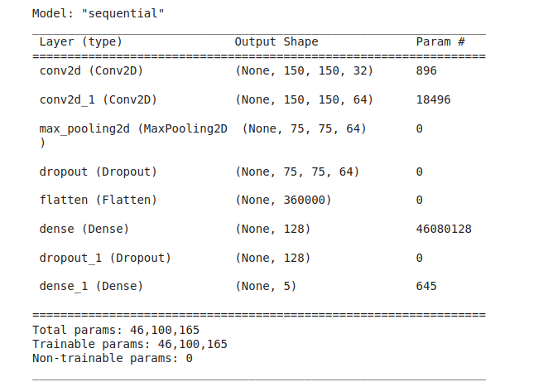

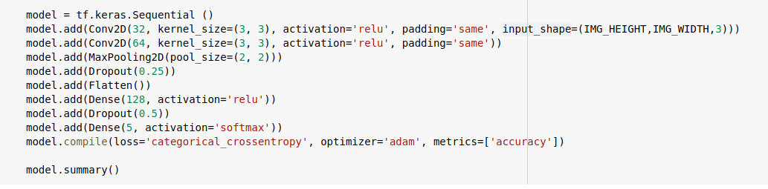
Model

Slide 14
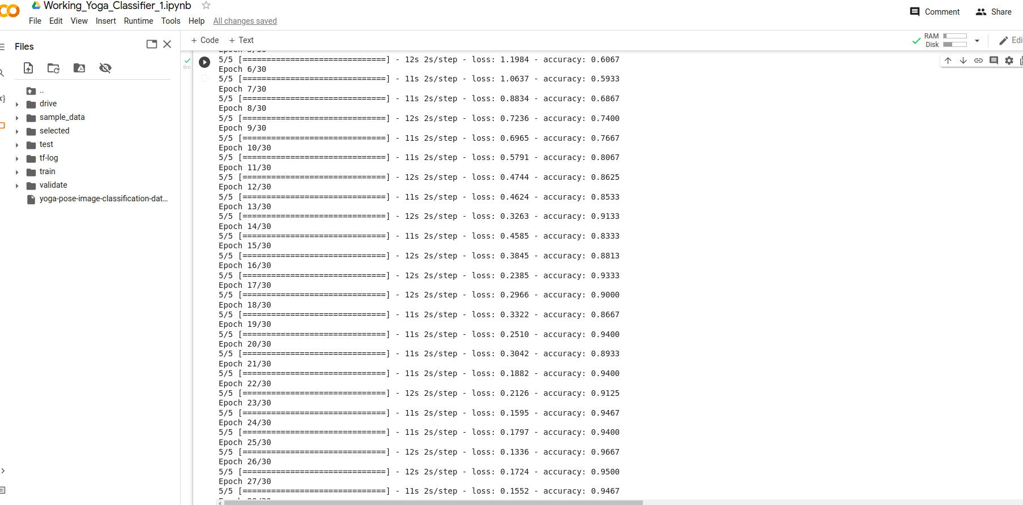
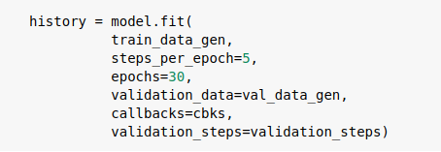
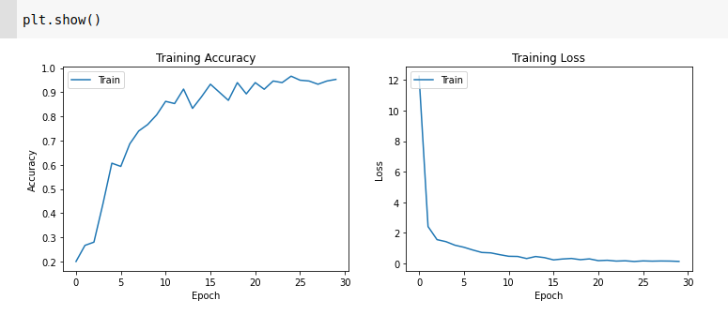
Results
Accuracy: 0.9467

Slide 15
Future Scope
The proposed system is confined to 4 yoga poses, where there are a total of more than 80 yoga poses.
The proposed dataset can be expanded by adding required yoga pose key points.
To include multiple yoga poses and to get model to work on many poses (classifying many poses) is challenging enough.
Keras pose estimation influences the performance of the model; steps should be taken to get key points when body parts are overlapped or missing to achieve better results.

Slide 16

Future Scope
The proposed system is confined to 4 yoga poses, where there are a total of more than 80 yoga poses. The proposed dataset can be expanded by adding required yoga pose key points. The technology may also be used to make real-time predictions and self-training on a mobile device. There are several instances of real-life applications in which a single individual posture evaluation will not be enough; for example, a pose estimate in crowded environments will need to detect and recognize the pose of each participant. To include many poses and to get model works on many poses (classifying many poses) is challenging enough. Keras pose estimation influences the performance of the model; steps should be taken to get key points when body parts are overlapped or missing to achieve better results. This method to extract angles as features can be used for other applications like activity detection and sports activity monitoring.
Thank You

